Slide 1
American Potential for Export of LNG
Martin Hupka, Chief Commercial Officer

Slide 2
Information Regarding Forward-Looking Statements
This presentation contains statements that are not historical fact and constitute forward-looking statements within the meaning of the Private Securities Litigation Reform Act of 1995. Forward-looking statements are based on assumptions with respect to the future, involve risks and uncertainties, and are not guarantees of performance. Future results may differ materially from those expressed in the forward- looking statements. These forward-looking statements represent our estimates and assumptions only as of August 5, 2020. We assume no obligation to update or revise any forward-looking statement as a result of new information, future events or other factors. In this presentation, forward-looking statements can be identified by words such as “believes,” “expects,” “anticipates,” “plans,” “estimates,” “projects,” “forecasts,” ”should,” could,” “would,” “will,” “confident,” “may,” “can,” “potential,” “possible,” “proposed,” “target,” “pursue,” “outlook,” “maintain,” or similar expressions, or when we discuss our guidance, strategy, goals, vision, mission, opportunities, projections or intentions. Factors, among others, that could cause our actual results and future actions to differ materially from those described in any forward-looking statements include risks and uncertainties relating to: California wildfires and the risk that we may be found liable for damages regardless of fault and the risk that we may not be able to recover any such costs from insurance, the wildfire fund established by California Assembly Bill 1054 or in rates from customers; decisions, investigations, regulations, issuances of permits and other authorizations, renewal of franchises, and other actions by (i) the Comisión Federal de Electricidad, California Public Utilities Commission (CPUC), U.S. Department of Energy, Public Utility Commission of Texas, and other regulatory and governmental bodies and (ii) states, cities, counties and other jurisdictions in the U.S., Mexico and other countries in which we operate or do business; the success of business development efforts, construction projects and major acquisitions and divestitures, including risks in (i) the ability to make a final investment decision and completing construction projects on schedule and budget, (ii) obtaining the consent of partners, (iii) counterparties’ financial or other ability to fulfill contractual commitments, (iv) the ability to complete contemplated acquisitions, and (v) the ability to realize anticipated benefits from any of these efforts once completed; the impact of the COVID-19 pandemic on our (i) ability to commence and complete capital and other projects and obtain regulatory approvals, (ii) supply chain and current and prospective counterparties, contractors, customers, employees and partners, (iii) liquidity, resulting from bill payment challenges experienced by our customers, including in connection with a CPUC-ordered suspension of service disconnections, decreased stability and accessibility of the capital markets and other factors, and (iv) ability to sustain operations and satisfy compliance requirements due to social distancing measures or if employee absenteeism were to increase significantly; the resolution of civil and criminal litigation, regulatory inquiries, investigations and proceedings, and arbitrations; actions by credit rating agencies to downgrade our credit ratings or to place those ratings on negative outlook and our ability to borrow at favorable interest rates; moves to reduce or eliminate reliance on natural gas and the impact of the extreme volatility and unprecedented decline of oil prices on our businesses and development projects; weather, natural disasters, accidents, equipment failures, computer system outages and other events that disrupt our operations, damage our facilities and systems, cause the release of harmful materials, cause fires and subject us to liability for property damage or personal injuries, fines and penalties, some of which may not be covered by insurance (including costs in excess of applicable policy limits), may be disputed by insurers or may otherwise not be recoverable through regulatory mechanisms or may impact our ability to obtain satisfactory levels of affordable insurance; the availability of electric power and natural gas and natural gas storage capacity, including disruptions caused by failures in the transmission grid, limitations on the withdrawal or injection of natural gas from or into storage facilities, and equipment failures; cybersecurity threats to the energy grid, storage and pipeline infrastructure, the information and systems used to operate our businesses, and the confidentiality of our proprietary information and the personal information of our customers and employees; expropriation of assets, the failure of foreign governments and state-owned entities to honor the terms of contracts, and property disputes; the impact at San Diego Gas & Electric Company (SDG&E) on competitive customer rates and reliability due to the growth in distributed and local power generation, including from departing retail load resulting from customers transferring to Direct Access, Community Choice Aggregation or other forms of distributed or local power generation, and the risk of nonrecovery for stranded assets and contractual obligations; Oncor Electric Delivery Company LLC’s (Oncor) ability to eliminate or reduce its quarterly dividends due to regulatory and governance requirements and commitments, including by actions of Oncor’s independent directors or a minority member director; volatility in foreign currency exchange, interest and inflation rates and commodity prices and our ability to effectively hedge the risk of such volatility; changes in trade policies, laws and regulations, including tariffs and revisions to or replacement of international trade agreements, such as the newly effective United States-Mexico-Canada Agreement, that may increase our costs or impair our ability to resolve trade disputes; the impact of changes to U.S. federal and state and foreign tax laws and our ability to mitigate adverse impacts; and other uncertainties, some of which may be difficult to predict and are beyond our control. These risks and uncertainties are further discussed in the reports that Sempra Energy has filed with the U.S. Securities and Exchange Commission (SEC). These reports are available through the EDGAR system free-of-charge on the SEC's website, www.sec.gov, and on the company's website, www.sempra.com. Investors should not rely unduly on any forward-looking statements. Sempra North American Infrastructure, Sempra LNG, Sempra Mexico, Sempra Texas Utilities, Oncor and Infraestructura Energética Nova, S.A.B. de C.V. (IEnova) are not the same companies as the California utilities, SDG&E or Southern California Gas Company, and Sempra North American Infrastructure, Sempra LNG, Sempra Mexico, Sempra Texas Utilities, Oncor and IEnova are not regulated by the CPUC.
2

Slide 3
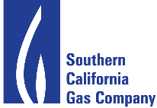
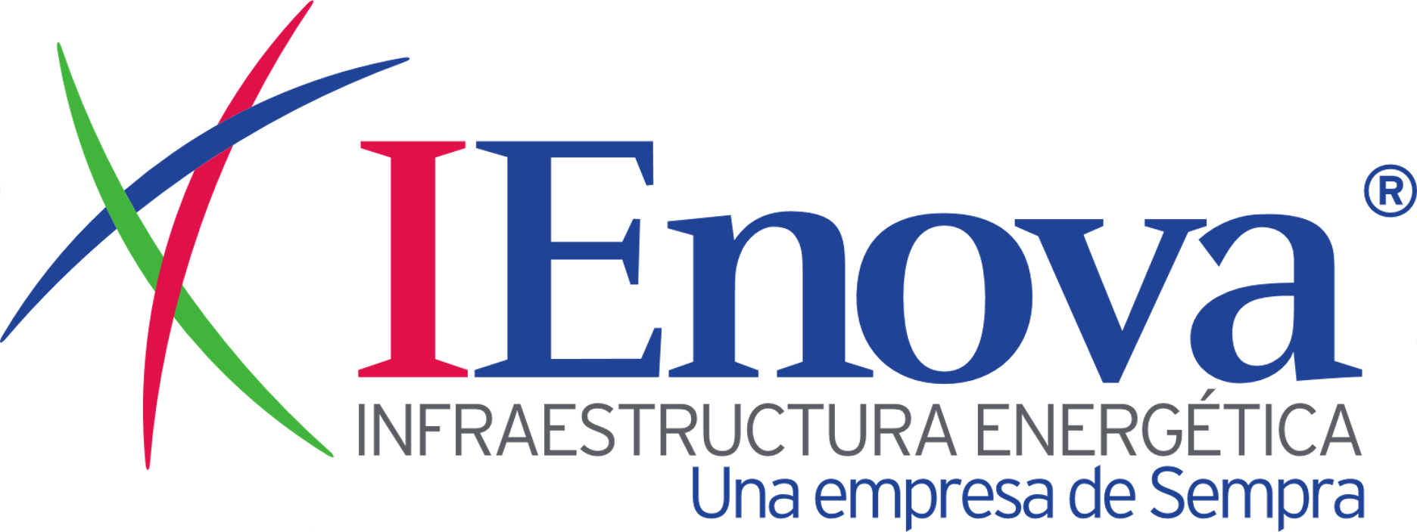
North America’s Premier Energy Infrastructure Company
Sempra Energy
150+ Years
Experience in Natural Gas Supply, Transmission and Distribution
Sempra Utilities
Regulated natural gas and electric utilities
Largest utility holding company in North America serving ~10% of the U.S. population
One of the largest buyers of natural gas in the U.S.
Operate 100,000 km of natural gas pipelines and 137 Bcf of underground natural gas storage
BBB+
Investment Grade Credit⁽¹⁾
US$68 Billion
Total Assets
Sempra North American Infrastructure
45+ Mtpa of natural gas liquefaction under construction, development, or operation across three sites, with a significant platform for long-term growth of LNG supply
18 Mtpa of LNG regasification developed, owned and operated
$12+ Billion of LNG infrastructure developed over 15 years
Largest private energy company in Mexico with 20+ years of operations; publicly traded on Mexican stock exchange
37 Million
Customers Served
18,000
Employees

Slide 4
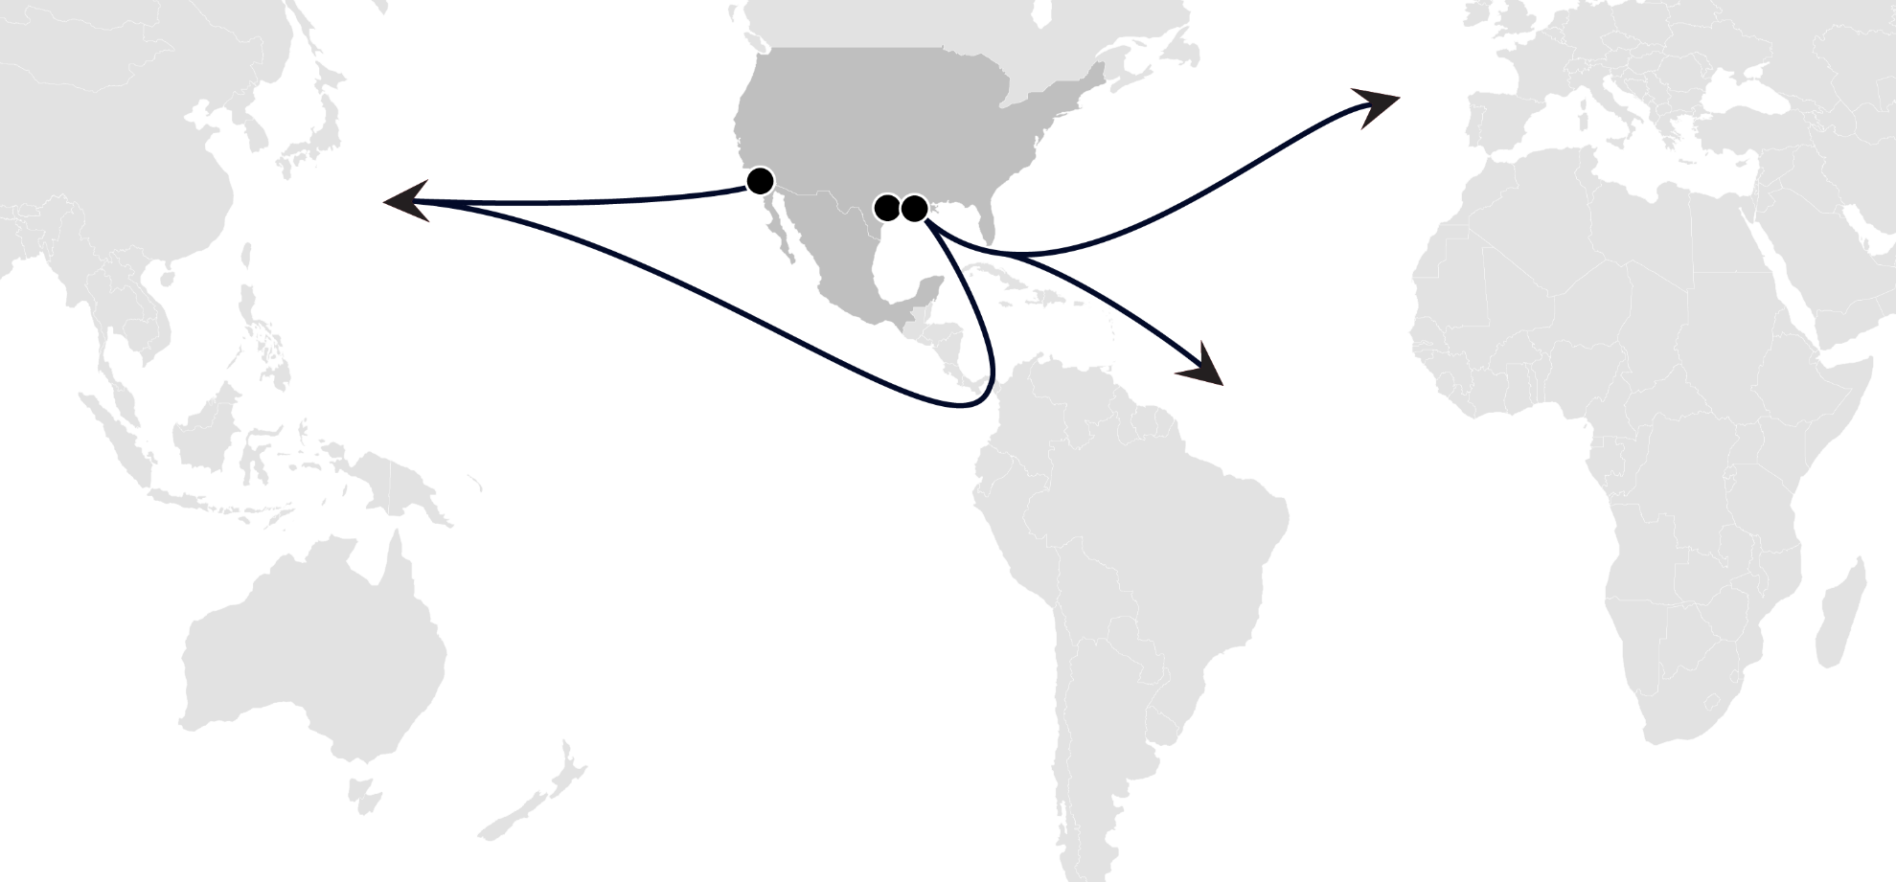
North America’s Premier LNG Infrastructure Company
Energia Costa Azul LNG
Cameron LNG
Port Arthur LNG
Phase 1 | Train 1 | ~3 Mtpa Brownfield expansion of LNG regas facility EPC contractor: TechnipFMC HOAs for SPAs for 100% of long-term sales FID: 2020 First LNG: 2024
Phase 2 | Trains 2 - 3 | ~12 Mtpa Under development First LNG: 2026+
Phase 1 | Trains 1 - 2 | ~12 Mtpa EPC contractor: Bechtel SPA: PGNiG for 2 Mtpa HOA: Saudi Aramco for 5 Mtpa and 25% equity FID: 2021 First LNG: 2025
Phase 2 | Trains 3 - 4 | ~12 Mtpa Pre-filed for Trains 3 & 4 and Louisiana Connector Extension pipeline
Phase 1 | Trains 1 - 3 | 12 Mtpa Brownfield expansion of LNG regas facility EPC contractor McDermott and Chiyoda FID: Aug 2014 Capacity of 4 Mtpa each subscribed by TOTAL/ Mitsui/Mitsubishi Commercial Operation: 2019
Phase 2 | Trains 4 - 5 | ~Up to 8 Mtpa Under development

Slide 5
Sempra LNG| Potential for Export of LNG
At Sempra LNG, we see two basic reasons underpinning the potential for export of LNG
Abundant US natural gas supplies than can be exported from the Atlantic and Pacific Coasts of North America to meet the long-term demand natural gas
Experience in – and commitment to – energy infrastructure transformation as partners

Slide 6
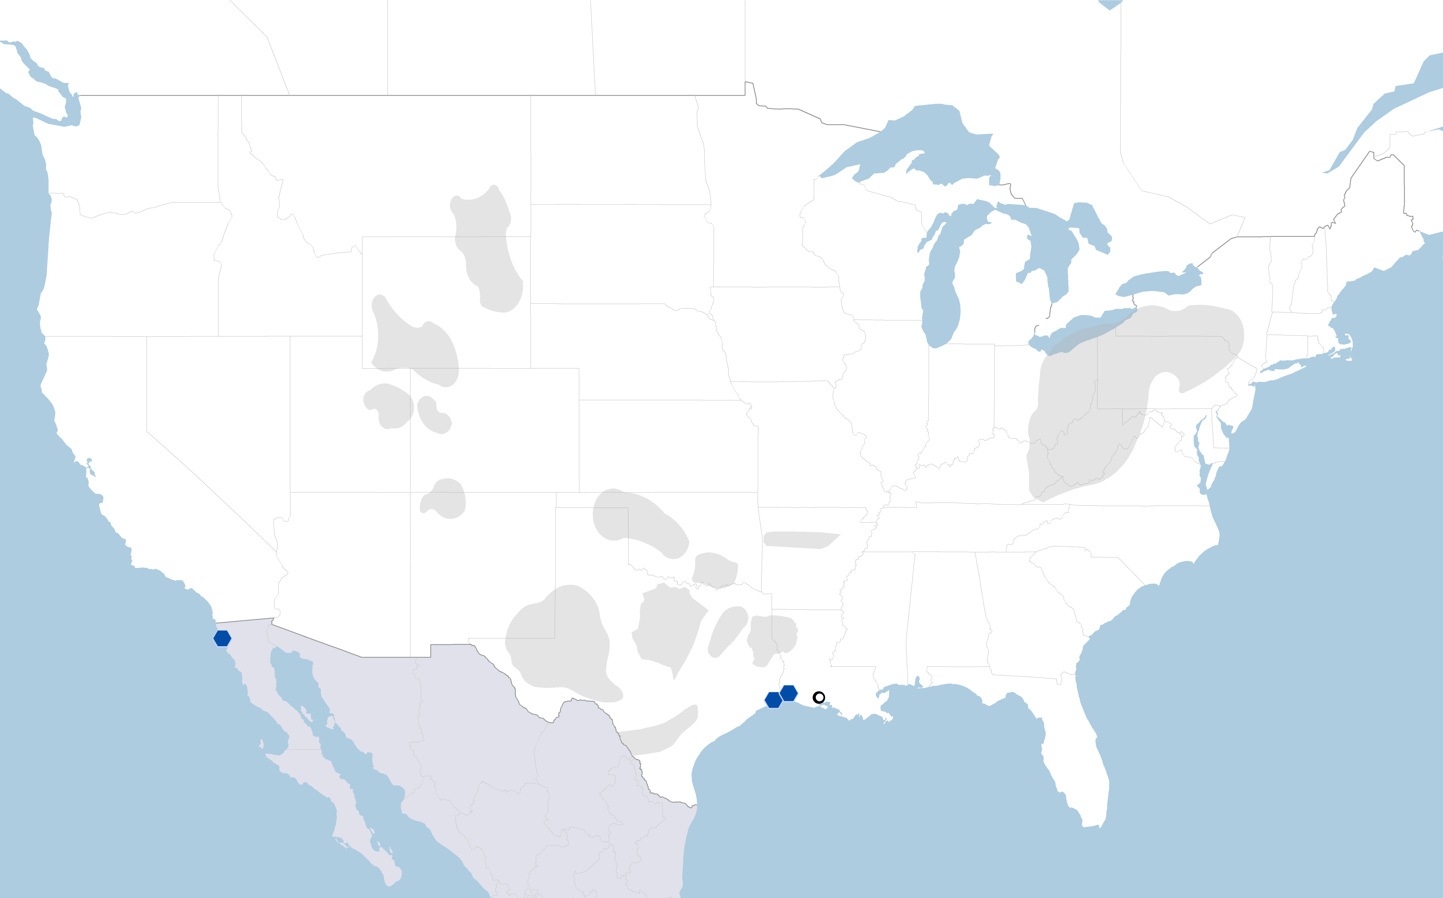
North America’s Abundant Gas Resources
North America is not just an associated gas story – the continent is awash in non-associated gas that is connected via existing infrastructure to export points
1,700 tcf (48 tcm) of natural gas resource at Henry Hub prices of less than $4/MMBtu
1,200 tcf (34 tcm) below $3.25/MMBtu, of which over 800 tcf (23 tcm) is non-associated
Associated Non-Associated
Natural Gas Reserves Assuming
HH<$4/MMBtu and WTI<$70/BBl
Sempra LNG Project
Rockies
100 tcf (~2,800 bcm)
Marcellus / Utica
554 tcf (~15,700 bcm)
Anadarko
52 tcf (~1,500 bcm)
San Juan
11 tcf (~300 bcm)
Arkoma
13 tcf (~370 bcm)
Permian
267 tcf (~7,500 bcm)
Haynesville
230 tcf (~6,500 bcm)
Energía Costa Azul LNG
Eagle Ford
74 tcf (~2,100 bcm)
Port
Arthur
LNG
Henry Hub
Cameron
LNG
North America has abundant, low-cost resource paired with robust pipeline infrastructure ensuring stable, low-cost supplies for LNG export projects
Sources: Sempra LNG Research, WoodMac 1H20 Long-term Outlook

Slide 7
Henry Hub Prices Sustainably Lower
Henry Hub (NYMEX) Historic Price and Forward Curves
Historic
Declining Henry Hub forward curves emphasize the confidence in the availability of abundant, low-cost North American natural gas
2010
2020
The price of natural gas at Henry Hub has declined and become range-bound, underscoring long-term reliability at stable prices
Sources: Morningstar historic NYMEX price and forward curves as of first trading day of each year (2010-2020)

Slide 8
U.S. Liquefaction | Flexible Solution
North America is seeing cargo cancellations, given the current market environment – proof of flexibility built into system
U.S. 2020 Cargo Cancellations
Flexible Solutions in Exceptional Times
Market expected to see oversupply in 2020-2021 as record volumes of U.S. LNG capacity entered service
Oversupply exacerbated by two warm winters and storage limits in key LNG markets, including Europe
Demand destruction arising from COVID-19 lockdowns and resulting economic downturns, exacerbated by oil price war
As project in-service dates and final investment decisions are delayed, coupled with resumed economic and gas demand growth, the long-term outlook is a constrained market
Source: S&P Global Platts

Slide 9
U.S. Liquefaction | Strong Long-Term Value Proposition
Fundamentals lay out a clear picture:
Gas and LNG demand continues to rise in all forecasts
Higher demand can be supported by greater build-out of gas infrastructure in variety of markets across Asia and Eastern Europe to further support global energy transition
Supply delays – with projects under construction and those waiting to take FID – indicate there will be insufficient capacity by the mid-2020s
The cyclicality and nature of the industry means a likely upside for LNG spot pricing in the late 2020s, especially if demand projections are higher than forecasted
Henry Hub-indexed LNG volumes will continue to be the best value when the stability of Henry Hub pricing is compared with more volatile oil-linked LNG pricing
Current LNG market (globally) is challenging but presents opportunities
“Recency bias” of low spot prices impacts market participants appetite for long-term commitments
Current spot market does not acknowledge the forecasted tightening of supply and demand
Therefore the window is open for structuring long-term arrangements to optimize supply before the market tightens
Sempra LNG projects provide geographic optionality to access long-term, low-cost supply

Slide 10
American LNG | In the Energy Transition
Sempra LNG’s North American platform is well positioned to help energy transformation
U.S. Perspectives
Sempra LNG Advantages
Long history of adapting to change, incorporating new technologies and maximizing the value of gas resources
Government support for U.S. LNG as a tool to support the global energy transition
This support extends to helping build downstream markets abroad through the U.S. Export-Import Bank and U.S. International Development Finance Corporation
Initiatives such as the Three Seas, can support significant build-out of long term regional natural gas infrastructure to support the energy transformation
Experienced in prior energy infrastructure transitions
Sempra is dedicated to the global energy transition and sees LNG as a pivotal tool for the world’s energy demand
Our history ensures that we understand the needs of end users going through the energy transformation
Well-capitalized parent provides the ability to navigate short-term market challenges
Building optionality – along the U.S. Gulf Coast and the Mexican West Coast – to bring North American natural gas to market

Slide 11
Sempra LNG | In the Energy Transition
Sempra LNG is a partner in building a lower-carbon future
Poland: Energy Path Forward
Sempra LNG Experience
Answer European call to reduce carbon emissions
Major investment in low-carbon energy, including solar and wind generation capacity
Natural gas seen as bridging fuel (as a base fuel and to complement renewables)
Expanding LNG and natural gas import infrastructure
Answering state, federal and global call to reduce carbon emissions, working in partnership with constituents
Developing and operating LNG export projects to meet global demand with the ability to expand our facilities with demand growth
Committed to a sustainable energy future and sustainable LNG

Slide 12
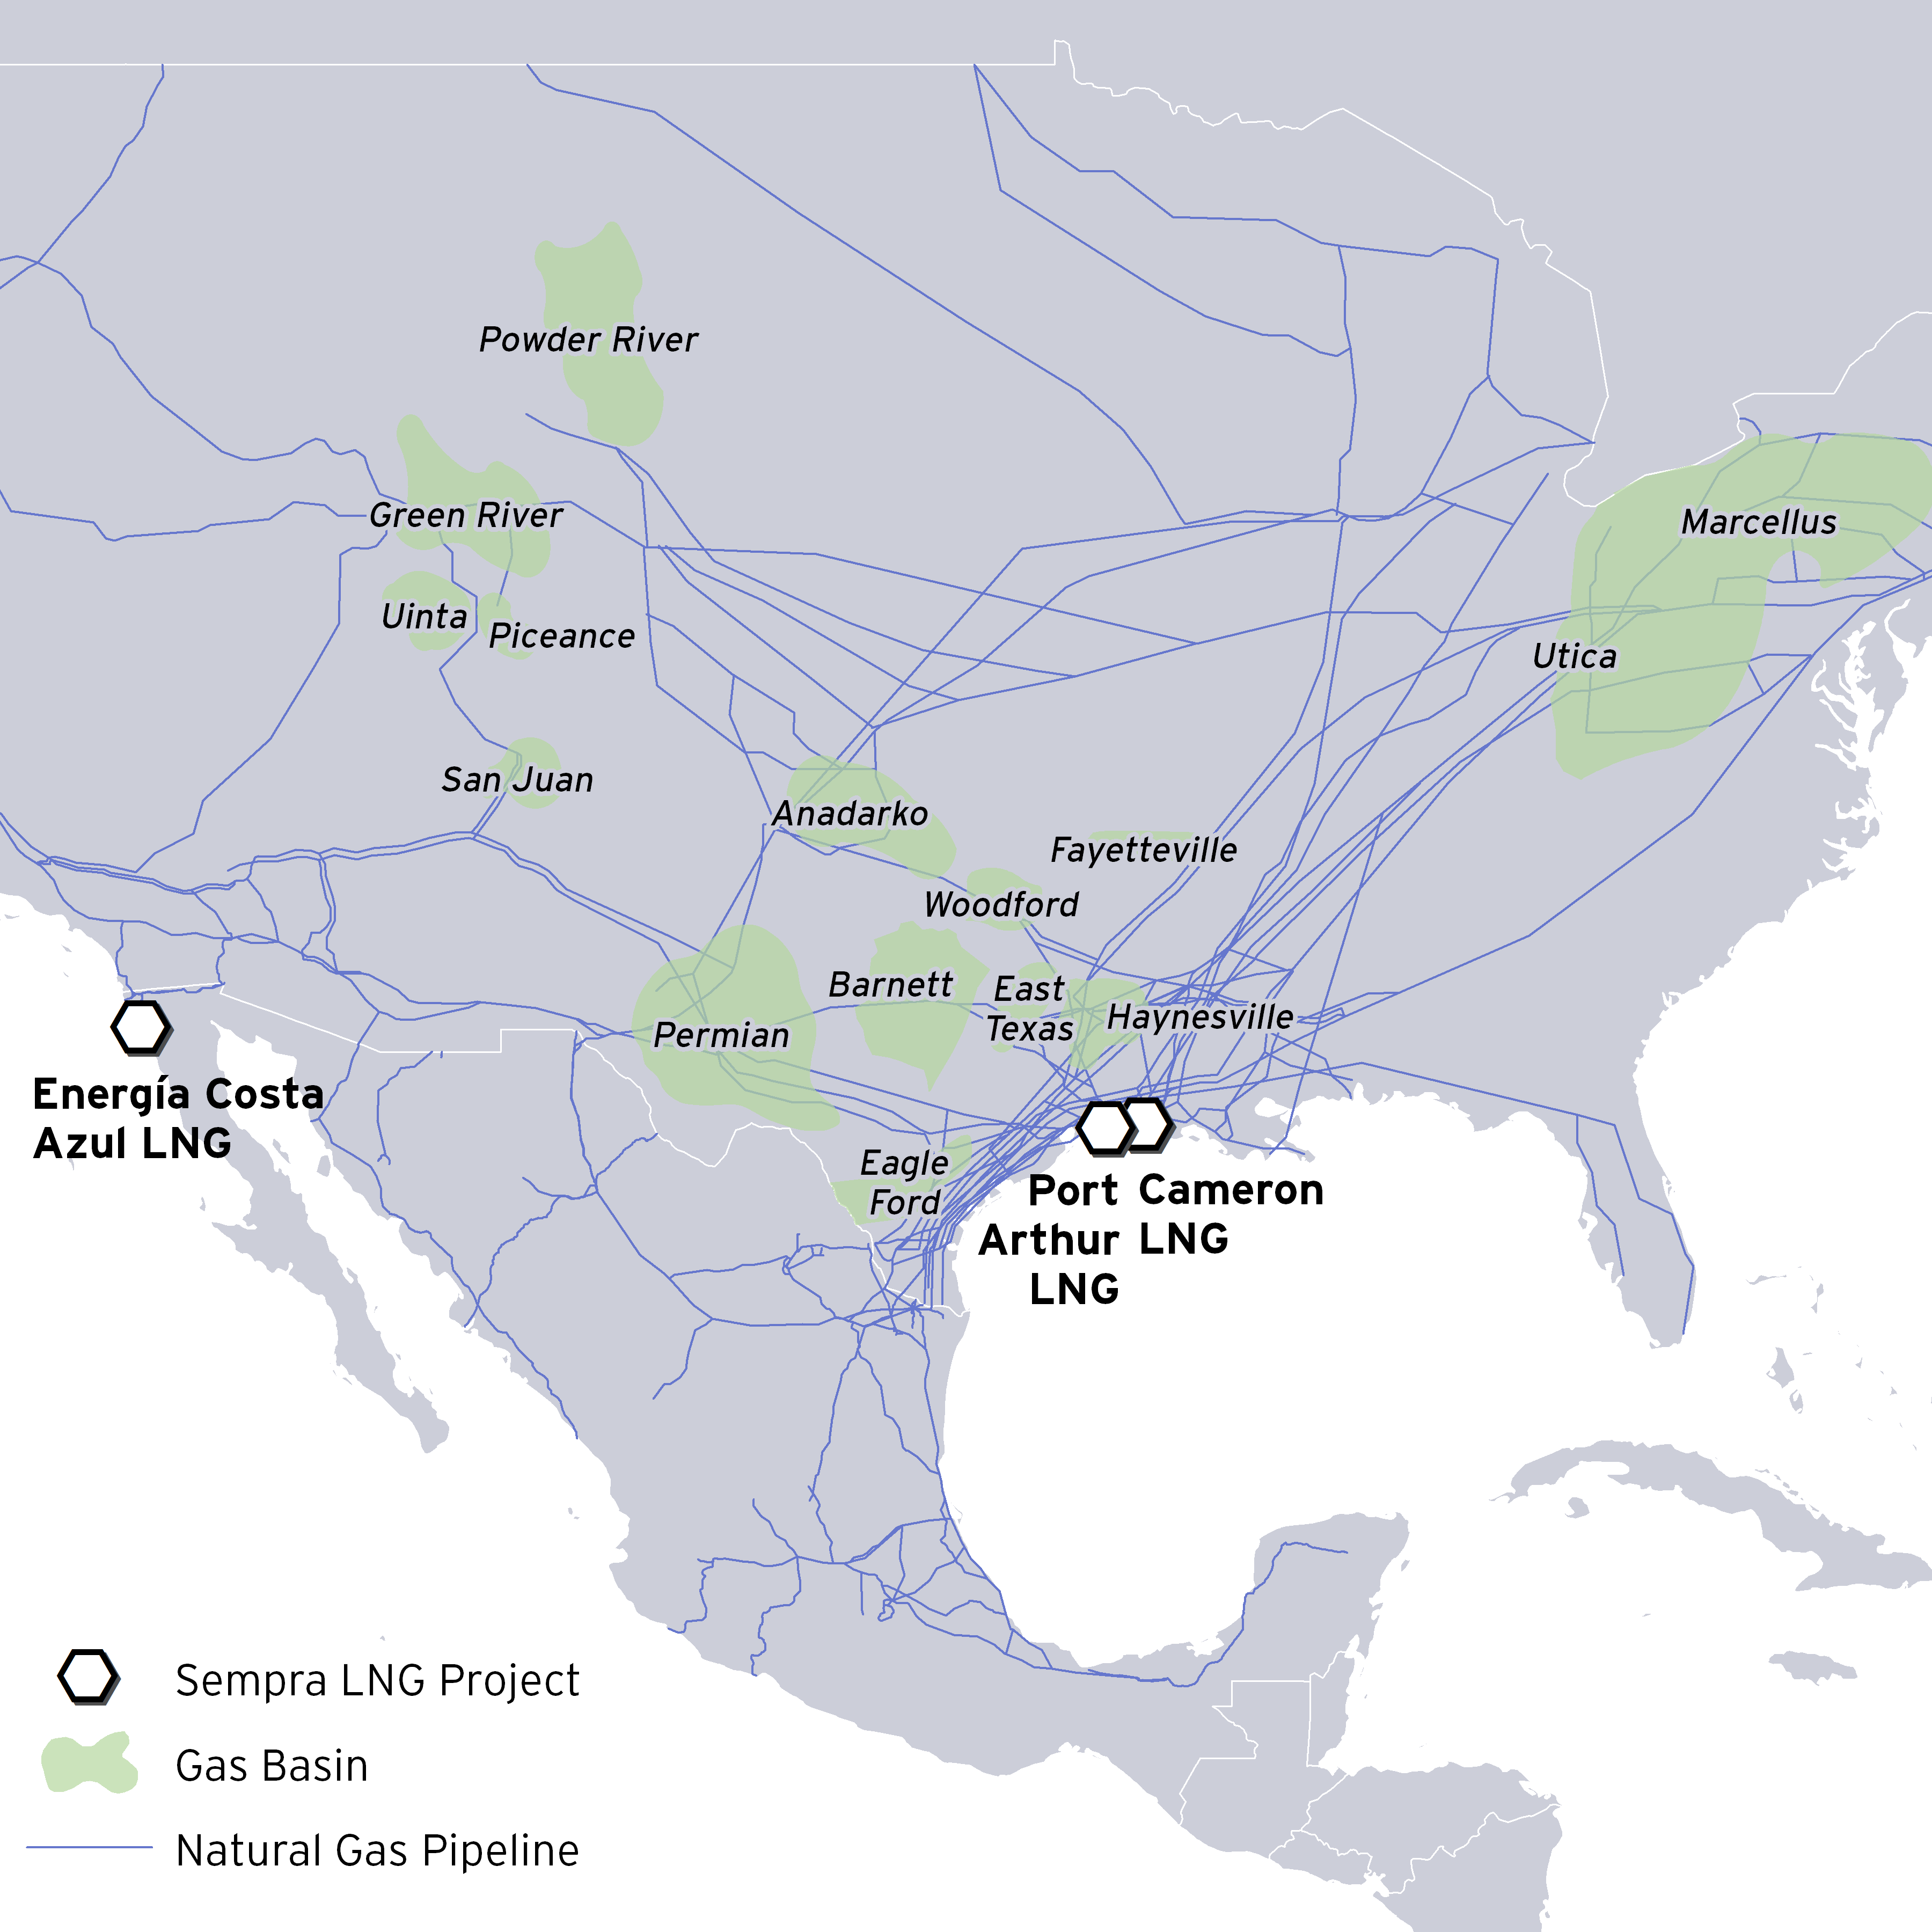
Sempra LNG | In the Energy Transition
Accessing abundant US natural gas to partner in the global energy transformation
Sempra LNG’s North American LNG Platform

