Slide 1
Bezpieczeństwo OT w dobie rewolucji cyfrowej
Robert Łukomski

Slide 3
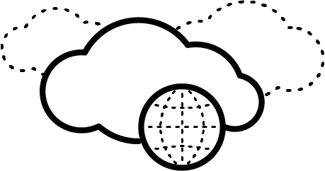
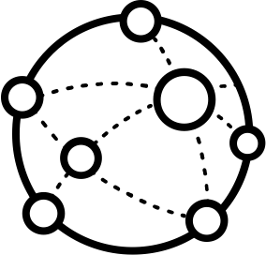
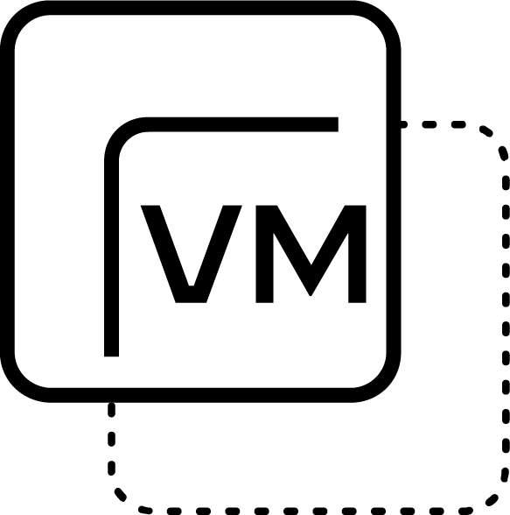
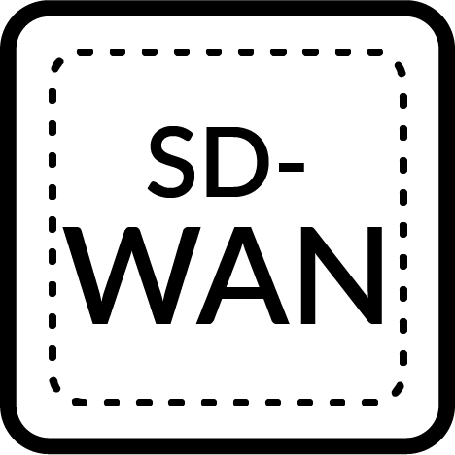
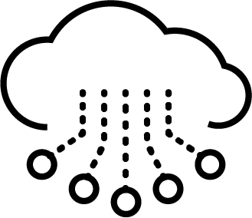
OT/ICS - Digital Transformation
Industrial Internet
Historian SCADA, IIoT,AI/ML
Public cloud
Internet
Internet
Internet
Enterprise Sys
Enterprise Sys
Enterprise Sys
IT
IT
IT
air-gap
Control Center
Control Center
Control Center
OT
OT
OT
OT LAN/WAN
OT LAN/WAN
OT LAN/WAN
5G
OT Remote Sites, substations, line/cells
IoT

Slide 4
Jak to może wyglądać?
1,3,4,6
Public cloud
Network Security Device:
Next Gen Firewall
OT/ICS Firewall w/DPI
IDS/IPS
Malware Sandbox
OT/IoT Asset ID
Cloud Firewall
5G Security
SD-WAN Security
Internet
Enterprise Sys
IT
1,3,4,6
1,2,3,4,5
Control Center
OT
OT LAN/WAN
5G
1,3,4,8
IoT
1,3,4,7

Slide 5
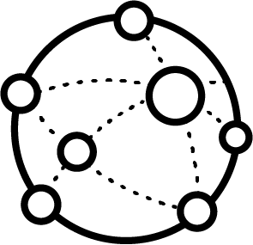
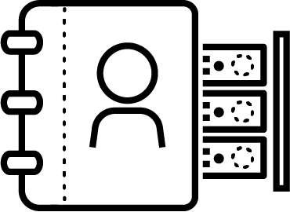
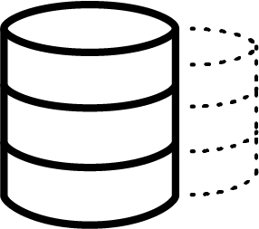
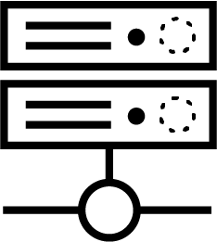
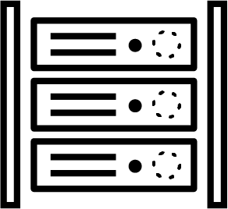
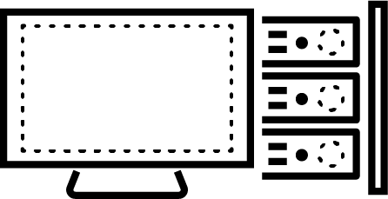
Segmentacja ICS & SCADA
Business
Internet
Email
Data Services
Level 4
DMZ
Historian Repl
Jump Server
Patch Server
H2M
Level 3.5
M2M
Manufacturing Zone
Manufacturing Operations
Historian
Process-specific
Engineer Station
Level 3
Control Systems
Level 2
HMI
Engineer Station
Intelligent Devices
Cell/Area Zone
Level 1
PLC
RTU
IED
Digital
Analog
Process
Physical Actuator
Level 0

Slide 6
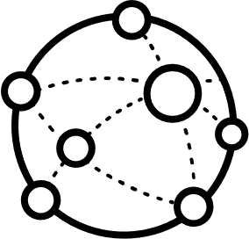
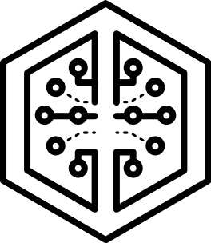
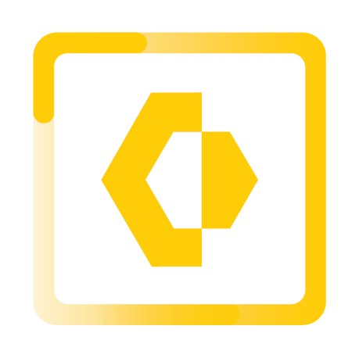
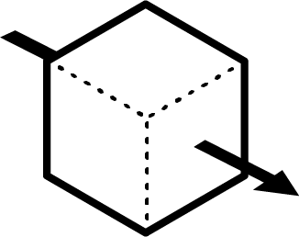
Segmentacja ICS & SCADA
Business
Sandboxing
AV signatures
IPS, IDS
URL Filtering
DMZ
Internet
Email
Data Services
Historian Repl
Jump Server
Patch Server
Level 4
Level 3.5
Behavioral analytics
Sandboxing
Machine Learning
AV signatures
IPS, IDS
URL Filtering
Sandboxing
Machine Learning
AV signatures
IPS, IDS
URL Filtering
Manufacturing Operations
Historian
Process-specific
Engineer Station
Level 3
SEGMENTATION GATEWAY
Behavioral analytics
Machine Learning
IPS, IDS
Behavioral analytics
Sandboxing
Machine Learning
AV signatures
IPS, IDS
URL Filtering
Control Systems
Intelligent Devices
Level 2
HMI
Engineer Station
Level 1
PLC
RTU
IED
Process
Physical Actuator
Level 0

Slide 7
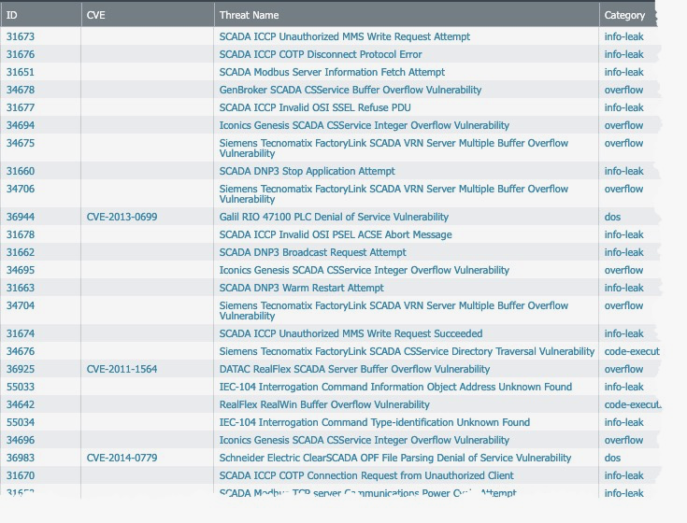
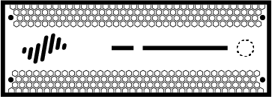
Sygnatury IPS pod kątem ICS
Product-Specific
Risky Protocol Commands

Slide 8
Sygnatury IPS pod kątem ICS
Anti-Spyware
Antivirus

Slide 9
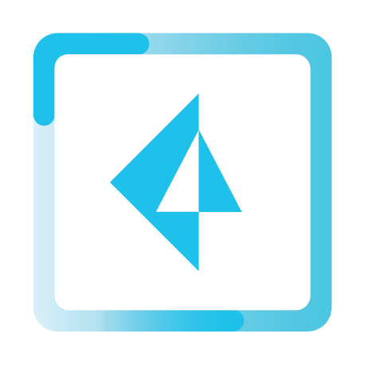
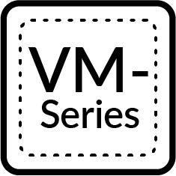
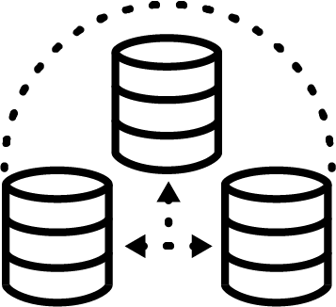
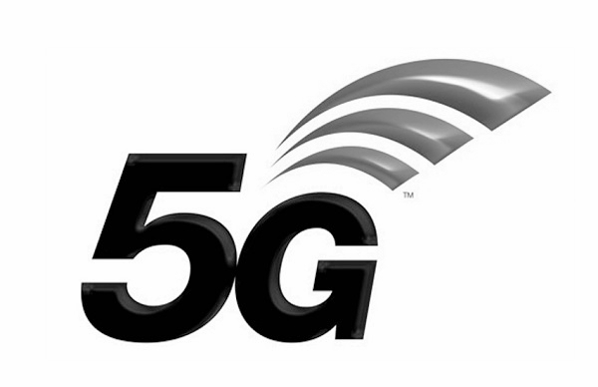
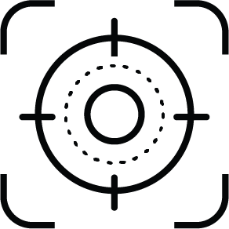
Bezpieczeństwo OT – kompletne rozwiązanie Strata, Cortex, & Prisma
Prisma™
Strata™
Cloud Provider
Next-generation Firewall platform
Consistent sensing & enforcement
Centralized, correlated data lake
ML/AI-based threat detection & response
Real-time threat intelligence
Industrial Cloud
C
Cloud
Endpoint
CORTEX Data Lake
Third-Party Data
Public & Private
SD-WAN
Security Operations Center
Information Technology
Operation Technology
IT - OT
Carpeted Space
Plant Floor
SOC
Cortex™ XSOAR
IT
OT
AutoFocus
3rd Party Tool
IT FW
Endpoint
OT FW
Endpoint

Slide 10
Partnerstwo globalne

Slide 11
Dziękuję za uwagę
paloaltonetworks.com

